Slide 1

RAS
2nd
WS

Slide 2
RAS
2nd
WS
IN COLLABORATION WITH
Computer Society
(CS)

Slide 3
RAS
2nd
WS
Hello!

Slide 4
ROBOTICS & AUTOMATION
BVPIEEE
Robotics and Automation Society (RAS)

Slide 5
Differential Drive
DD
My First Bot
Notes:
Tank
No steering / fixed wheels

Slide 6
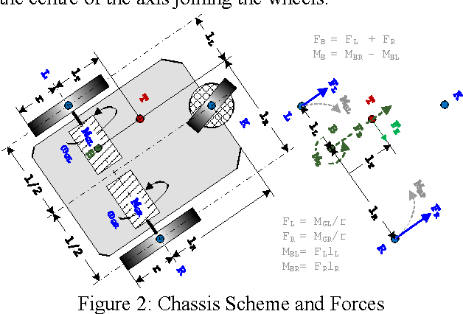
DD
A differential wheeled robot is a mobile robot whose movement is based on two separately driven wheels placed on either side of the robot body.
It can thus change its direction by varying the relative rate of rotation of its wheels and hence does not require an additional steering motion.
Notes:
JK … SKIP TO NEXT SLIDE

Slide 7
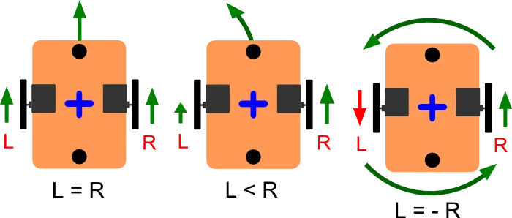
HOW DOES THE DD WORK?

Slide 8
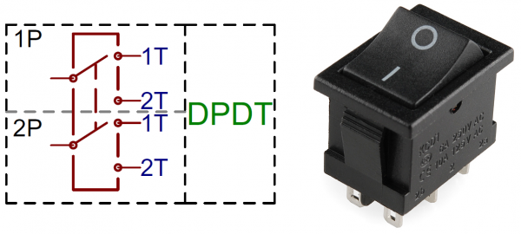
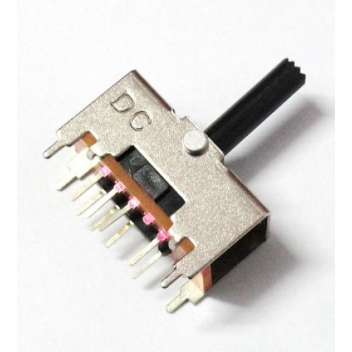
Double Pole Double Throw
(DPDT)

Slide 9
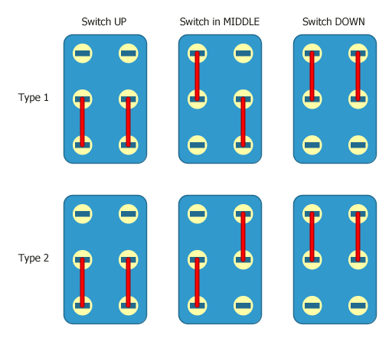
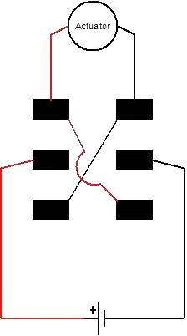

Slide 10
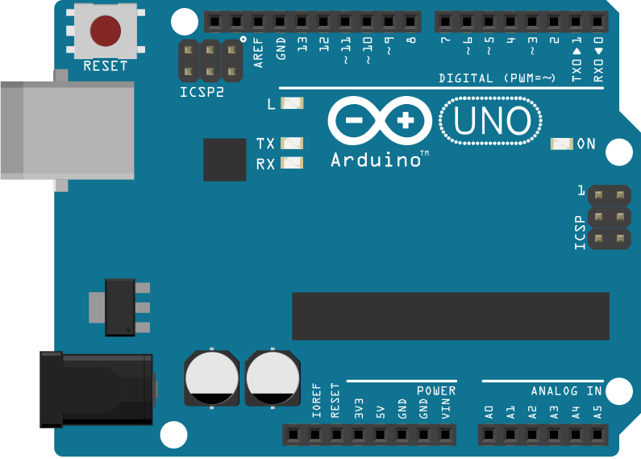
Arduino
Arduino is an open-source platform
Arduino IDE (Integrated Development Environment)

Slide 11
Arduino
What is an Arduino?
Why use Arduino?
Types of arduinos
Pro mini
Nano
Uno
Mega

Slide 12
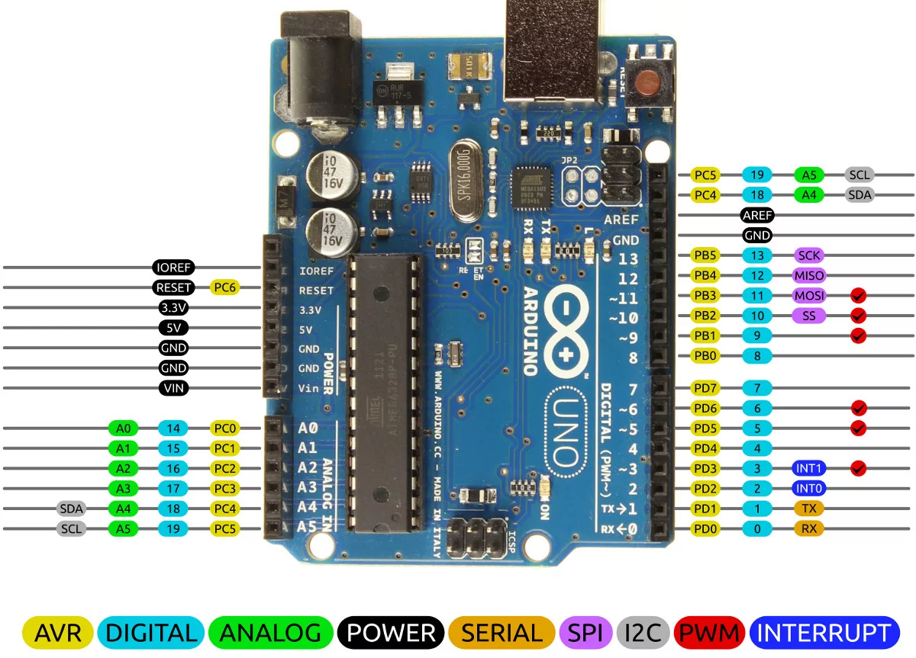

Slide 13
PWM-PULSE WIDTH MODULATION
PWM IS DONE TO CHANGE THE AVERAGE VALUE OF VOLTAGE GIVEN IN A CIRCUIT.
DUTY CYCLE: FRACTION OF A PERIOD IN
WHICH A SYSTEM IS IN ACTIVE STATE.
EXPRESSED OR DEPICTED AS A
SQUARE WAVE.

Slide 14
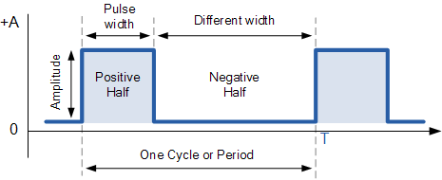
By changing the Pulse Width, we can change the average value of the Voltage in a circuit!

Slide 15
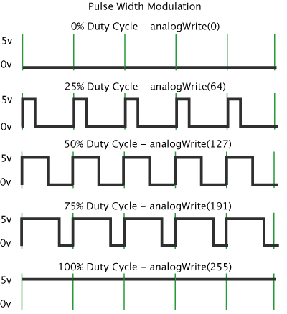
DUTY CYCLES

Slide 16
Actuators and Sensors
Let's get moving

Slide 17
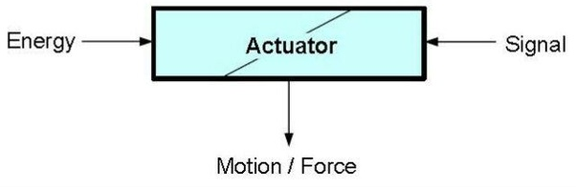
WHAT IS AN ACTUATOR?
FORMS THE MOVING AND CONTROLLING MECHANISM FOR A SYSTEM.
RECEIVES A CONTROL SIGNAL AND RESPONDS BY CONVERTING ITS ENERGY INTO MECHANICAL MOTION.
TYPES: ELECTRICAL ACTUATORS, HYDRAULIC ACTUATORS, MAGNETIC ACTUATORS AND MECHANICAL ACTUATORS.

Slide 18
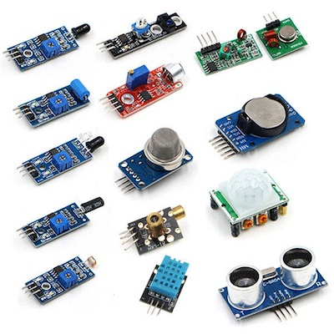
SENSORS

Slide 19
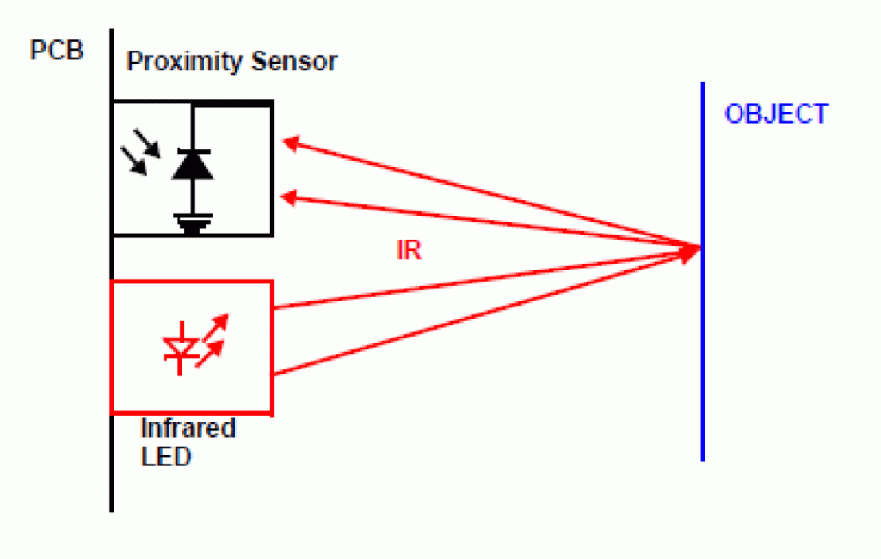
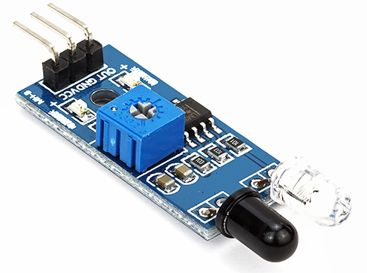
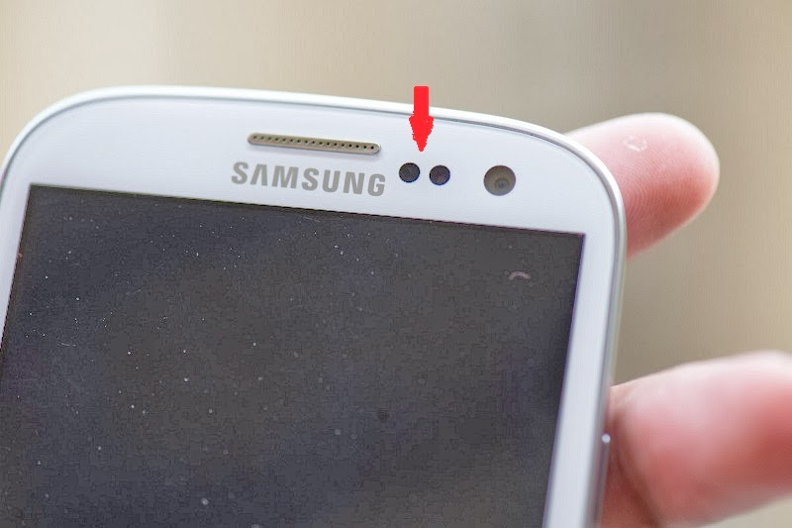
INFRARED
SENSORS

Slide 20
H-BRIDGE
SWITCHES THE POLARITY OF A VOLTAGE APPLIED TO A LOAD.
PARTICULARLY USED TO REVERSE THE DIRECTION OF A MOTOR BUT CAN ALSO BE USED TO STOP THE MOTOR.

Slide 21
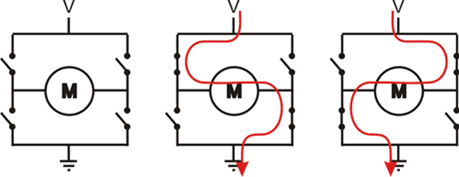

Slide 22
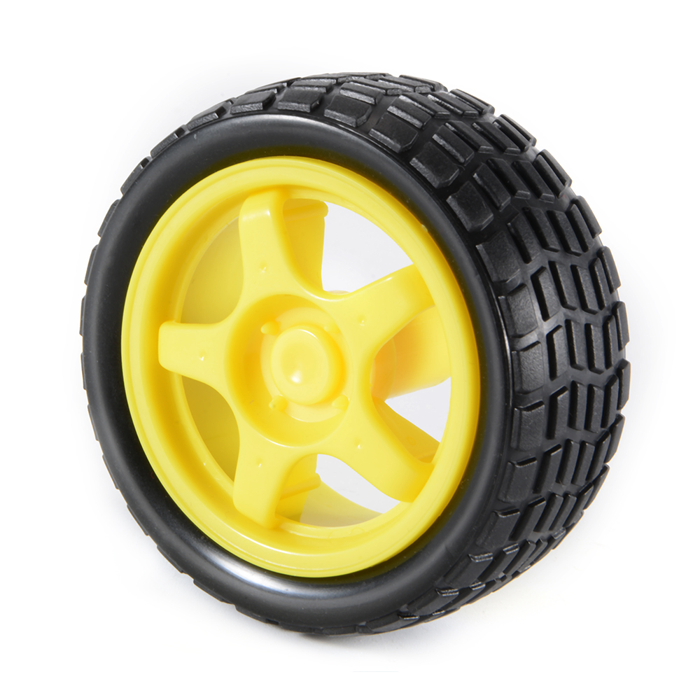
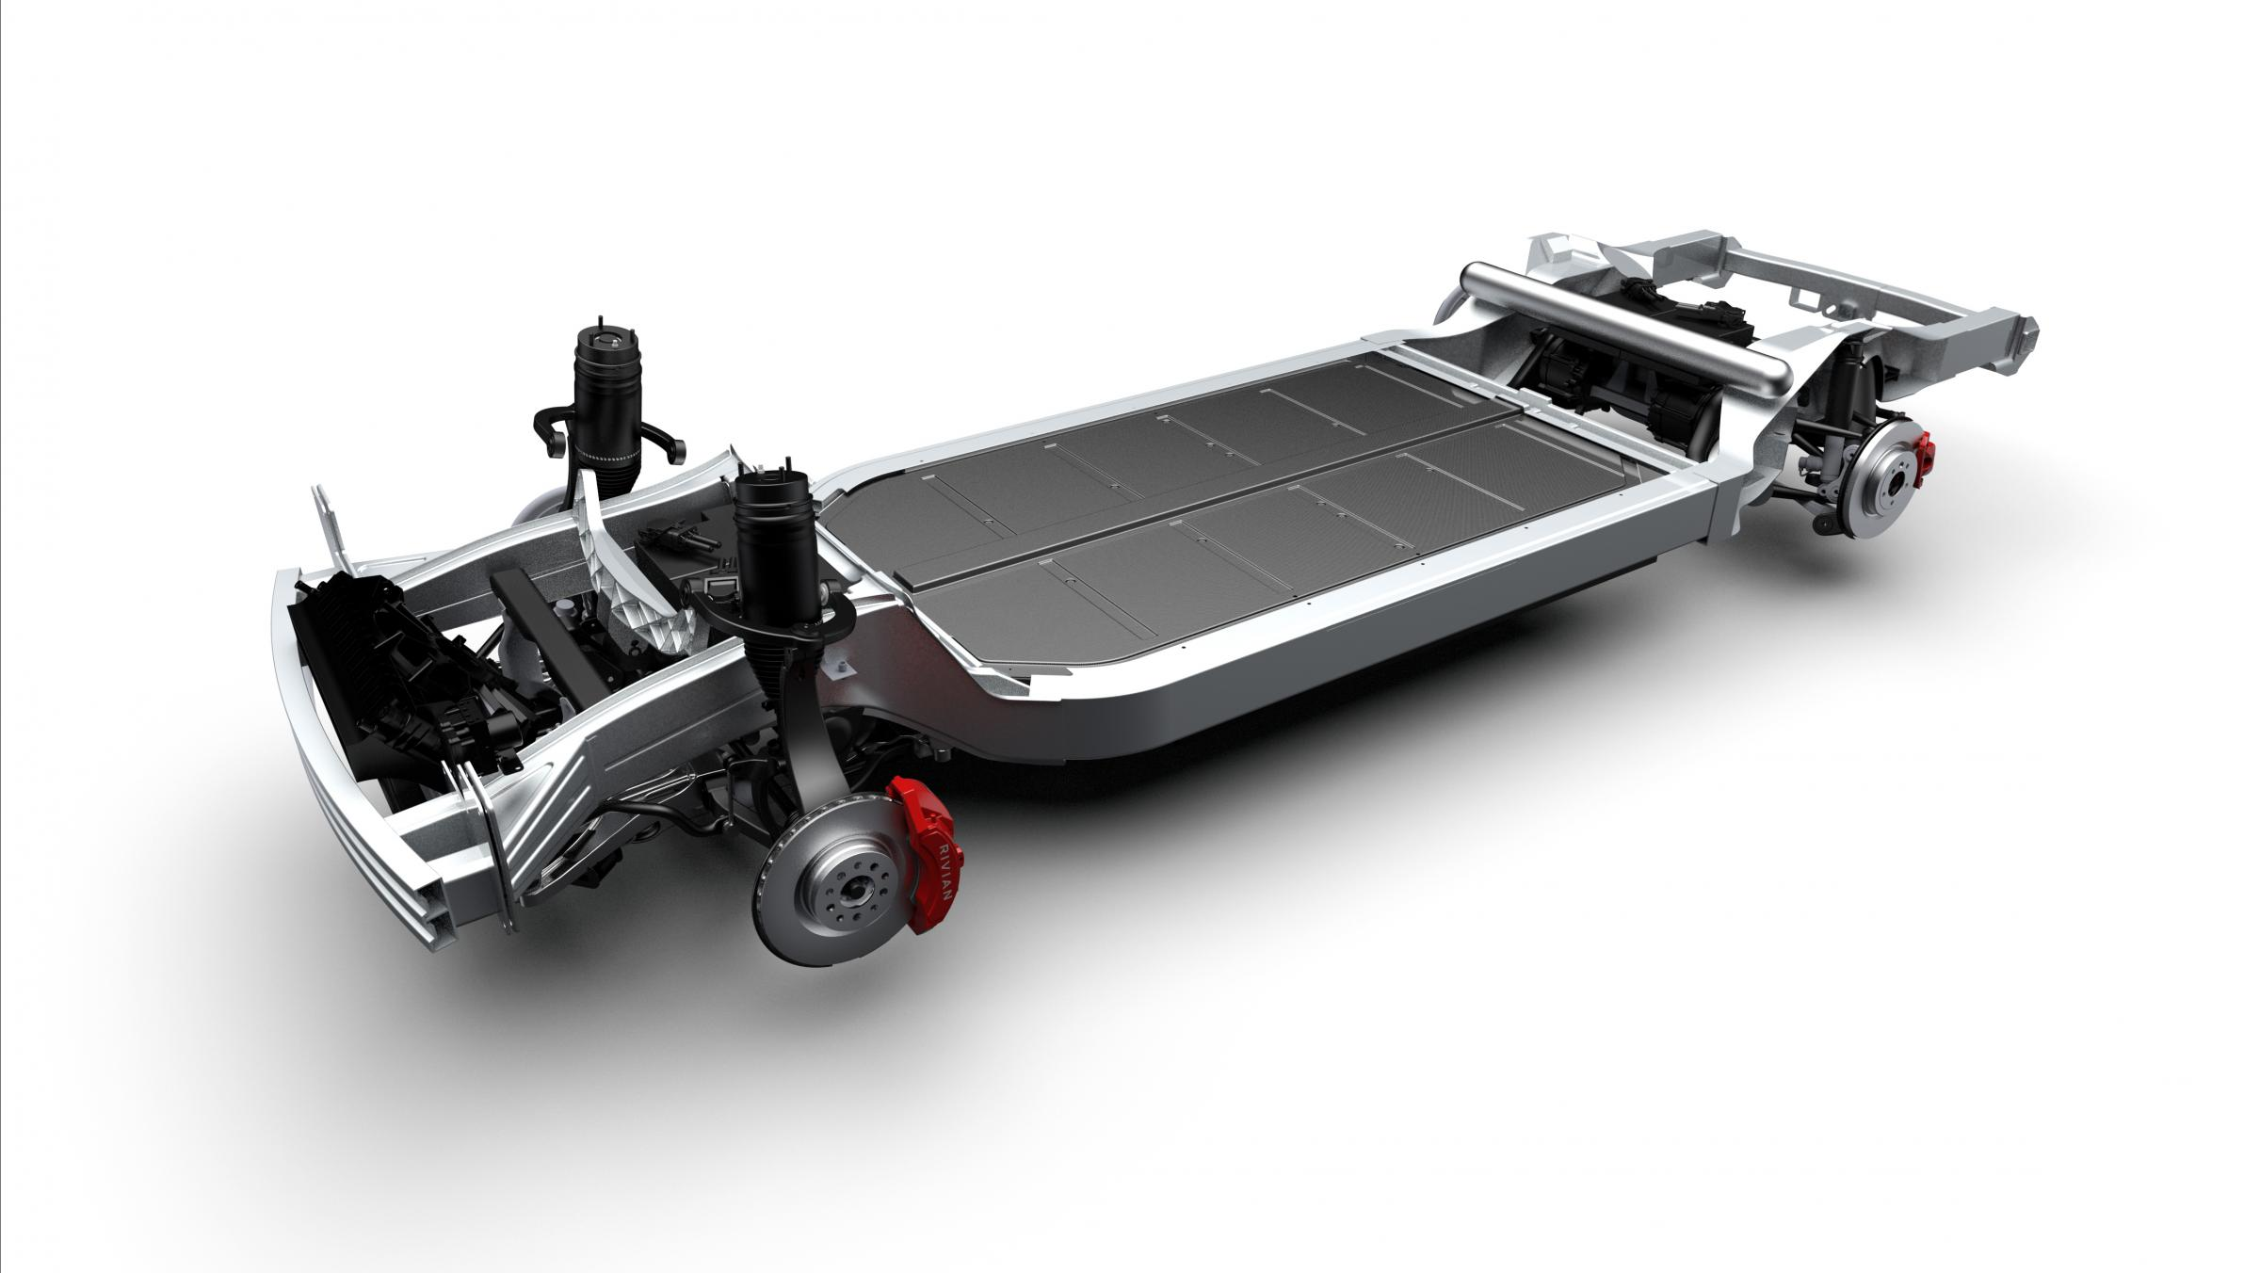
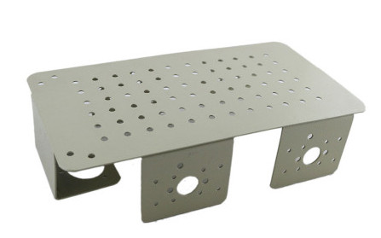
CHASSIS and WHEELS

Slide 23
You now have the knowledge required for building a LFR bot
👍

Slide 24
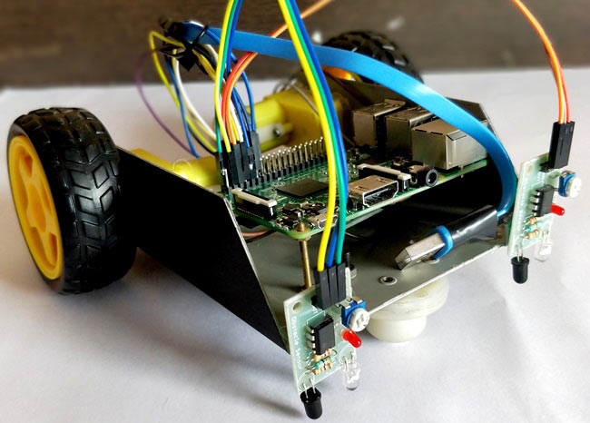
Let’s see the bot!

